Slide 1
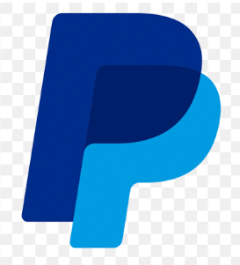
PayPal Transactions Analysis Project - BY Surabhi Goyal

Slide 2
Agenda
Introduction
Overview
Objectives
Dataset Details
Data Analysis In MySQL
Business Insights

Slide 3



INTRODUCING SURABHI GOYAL
Result-oriented Data Analyst with 2+ years of experience and a proven track record of extracting valuable insights from complex datasets. Proficient in SQL, Python, and data visualization tools, I utilize statistical analysis and data mining techniques to inform and drive strategic business decisions.

Slide 4
OVERVIEW
The project involves leveraging extensive databases within a dynamic global digital payment platform PayPal to increase transaction volume and improve user satisfaction. The goal is to identify actionable insights from the transaction data that can drive strategic decisions, improve risk management, and ultimately increase the platform's market share and profitability in the competitive digital payment industry.

Slide 5
OBJECTIVES
User Behavior and Engagement: Identify key user segments and analyze transaction patterns to enhance customer retention and value.
Geographic Insights: Analyze transaction distribution to uncover high-performing regions and growth opportunities.
Sales Optimization: Evaluate sales trends and customer preferences to boost platform adoption and revenue.
Platform Performance: Monitor KPIs like transaction volume, revenue, and user growth to ensure optimal platform performance.

Slide 6
DATASET DETAILS
Countries Table: This table contains information about different countries. It includes the name of each country to facilitate various analyses and operations.
Currencies Table: This table provides a comprehensive list of currencies used in financial transactions. The structure allows for efficient referencing of currencies throughout the database, enabling accurate currency-related operations and reporting across various financial processes and international transactions.
Merchants Table: This table captures essential information about businesses or individuals who accept payments through the platform. This structure enables efficient merchant management, facilitates reporting, and supports tailored services based on geographical considerations.

Slide 7
Transactions Table: This data structure captures detailed information about financial exchanges within the system. The comprehensive record of transactions forms the core of the system, facilitating various financial operations, user activity tracking, and providing essential data for analytics and compliance purposes.
Users Table: This data structure contains essential information about individuals who utilize the platform for financial transactions. This comprehensive user profile supports various functions including personalized services, security measures, and demographic analysis to inform business strategies and improve user experience.

Slide 8
DATA ANALYSIS IN MYSQL

Slide 9
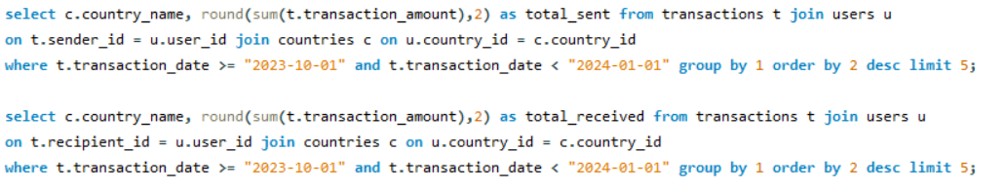
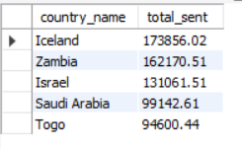
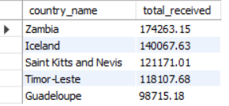
Problem statement:
Determine the top 5 countries by total transaction amount for both sending and receiving funds in the last quarter of 2023 (October to December 2023). Provide separate lists for the countries that sent the most funds and those that received the most funds. Additionally, round the total sent and total received amounts to 2 decimal places.

Slide 10
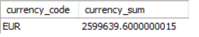
Problem statement:
To effectively manage risk, it's crucial to identify and monitor high-value transactions. Find transactions exceeding $10,000 in the year 2023 and include transaction ID, sender ID, recipient ID (if available), transaction amount, and currency used.
Problem statement:
The finance team is analyzing currency conversion trends to manage exposure to currency risks. Which currency had the highest transaction amount from in the past one year up to today indicating the greatest exposure? (assume today is 22-05-2024)

Slide 11
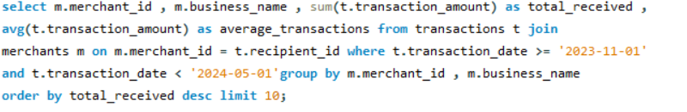
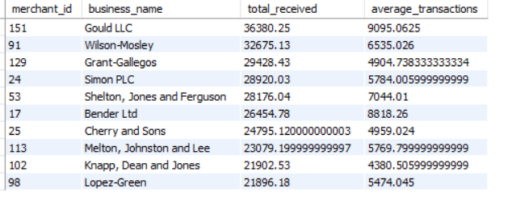
Problem statement:
Your task is to analyze the transaction data and determine the top 10 merchants, sorted by the total transaction amount they received, within the period from November 2023 to April 2024. For each of these top 10 merchants, provide the following details: merchant ID, business name, the total transaction amount received, and the average transaction amount.

Slide 12
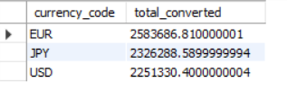
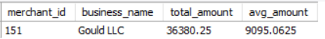
Problem statement:
The finance team wants to analyze the company's exposure to currency risks. Analyze currency conversion trends from 22 May 2023 to 22 May 2024. Calculate the total amount converted from each source currency to the top 3 most popular destination currencies.
Problem statement:
The sales team wants to identify top-performing merchants. Which merchant should be considered as the most successful in terms of total transaction amount received between November 2023 and April 2024?

Slide 13
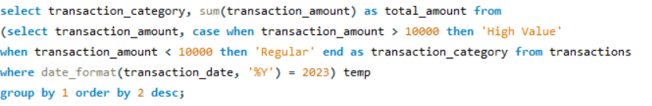
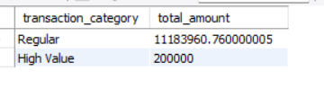
Problem statement:
The finance team is evaluating transaction classifications. Categorize transactions as 'High Value' (above $10,000) or 'Regular' (below $10,000) and calculate the total amount for each category for the year 2023.

Slide 14
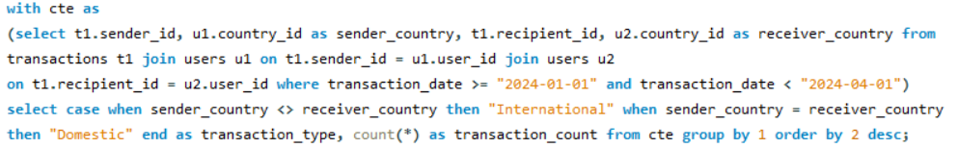
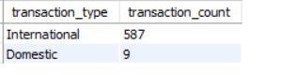
Problem statement:
To meet compliance requirements, the finance team needs to identify the nature of transactions conducted by the company. Specifically, you are required to analyze transaction data for the first quarter of 2024 (January to March).Your task is to create a new column in the dataset that indicates whether each transaction is international (where the sender and recipient are from different countries) or domestic (where the sender and recipient are from the same country). Additionally, provide a count of the number of international and domestic transactions for this period.

Slide 15
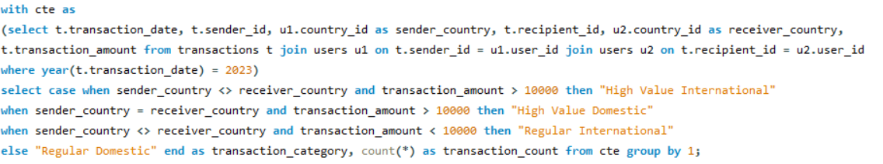
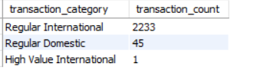
Problem statement:
As part of a financial analysis, the team needs to categorize transactions based on multiple criteria. Create a report that categorizes transactions into 'High Value International', 'High Value Domestic', 'Regular International', and 'Regular Domestic' based on the following criteria: High Value: transaction amount > $10,000, International: sender and recipient from different countries. Write a query to categorize each transaction and count the number of transactions in each category for the year 2023.

Slide 16

BUSINESS INSIGHTS
'Iceland', 'Zambia' and 'Israel' are the countries that sent the most funds and 'Zambia', 'Iceland' and 'Saint Kitts and Nevis' are those countries that received the most funds in the last quarter of 2023 so it assist in optimizing marketing strategies, tailoring financial products, and managing cross-border transaction risks.
High-value transactions (2 lacs) were flagged, highlighting key users and regions contributing to significant monetary movement. This data is crucial for risk assessment, fraud detection, and targeted customer engagement strategies.
'Gould LLC' , 'Wilson-Mosley', 'Grant-Gallegos', 'Simon PLC', 'Shelton, Jones and Ferguson' are top 5 merchants with the highest transaction volumes, providing valuable information for prioritizing partnerships and customizing merchant services.

Slide 17
The top 3 currencies for conversion were identified, with 'Euro' leading as the most frequently transacted currency and it helps for currency risk management and strategic planning for forex operations.
There are '2233' Transactions which are categorized as 'regular international', while 'Regular Domestic' are '45' only and 'High Value International' with only '1' so mostly transactions are international with transaction amount < $10,000.
In 'Oct 2023', there are highest total transactions amount compare with other months in year 2023.
Users who transacted in at least 6 months were highlighted as consistent contributors, providing opportunities for enhanced retention strategies.
Users with an average transaction amount exceeding $5,000 were identified, aiding in segmenting high-value customers for tailored services.

Slide 18
Recommendations based on the insights
For Marketing Teams: Focus on high-performing countries and consistently engaged users to design campaigns.
For Finance Teams: Utilize high-value transaction data to manage risks and address compliance requirements.
For Merchant Relations: Collaborate with top-performing merchants to sustain and grow transaction volumes.
For Risk Management: Monitor currency trends and implement measures to mitigate exposure to forex volatility.
For Customer Retention: Use insights from consistent and high-value user behavior to personalize offerings and improve engagement.

Slide 19

Thank you !
+91-8958936840
surabhigoyal198@gmail.com
https://github.com/SurabhiGoyal-Coder
https://www.linkedin.com/in/surabhi-goyal-36154a207

